Slide 1
S-Re Presentation
SDA Lab Project
2021-SE-39

Slide 2
AGENDA
Introduction
Objectives
Architecture
Requirements
Development
User Interface
Conclusion

Slide 3
Introduction
Project title “Car Wash Management System”
Windows Console Application
C#
MS SQL

Slide 4
The project main target is the administrator of Car Wash Company.
The project main objective make easier to manage Employees, Customers and Washing Services Stats for Admin.
The project keeps track of all transactions histories and funds and stores them for long term usage.
Objectives

Slide 5
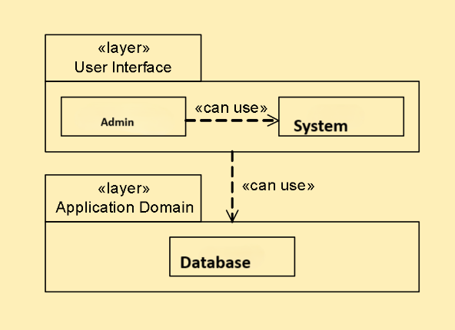
Architecture

Slide 6
Requirements
Employees Management
Customer Management
Vehicles Service Management
Funds Management
Receipt Printout

Slide 7
Development
OOP Principles
Abstraction
Encapsulation
Polymorphism
Design Patterns
Singleton Design Pattern
Refactoring

Slide 8
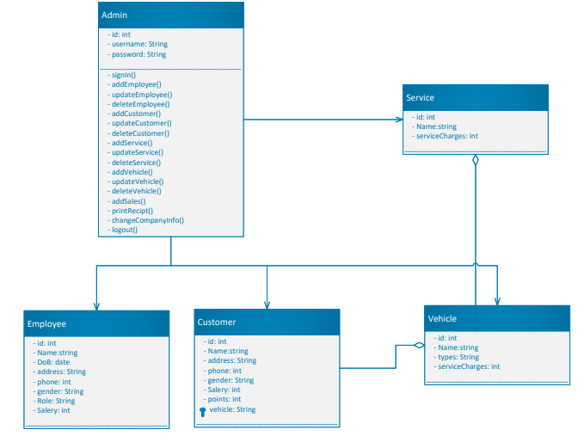

Slide 9
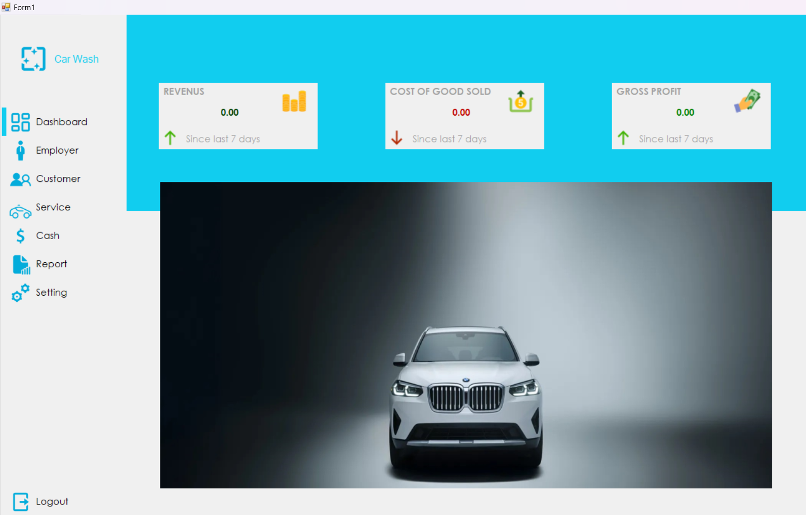

User Interface

Slide 11
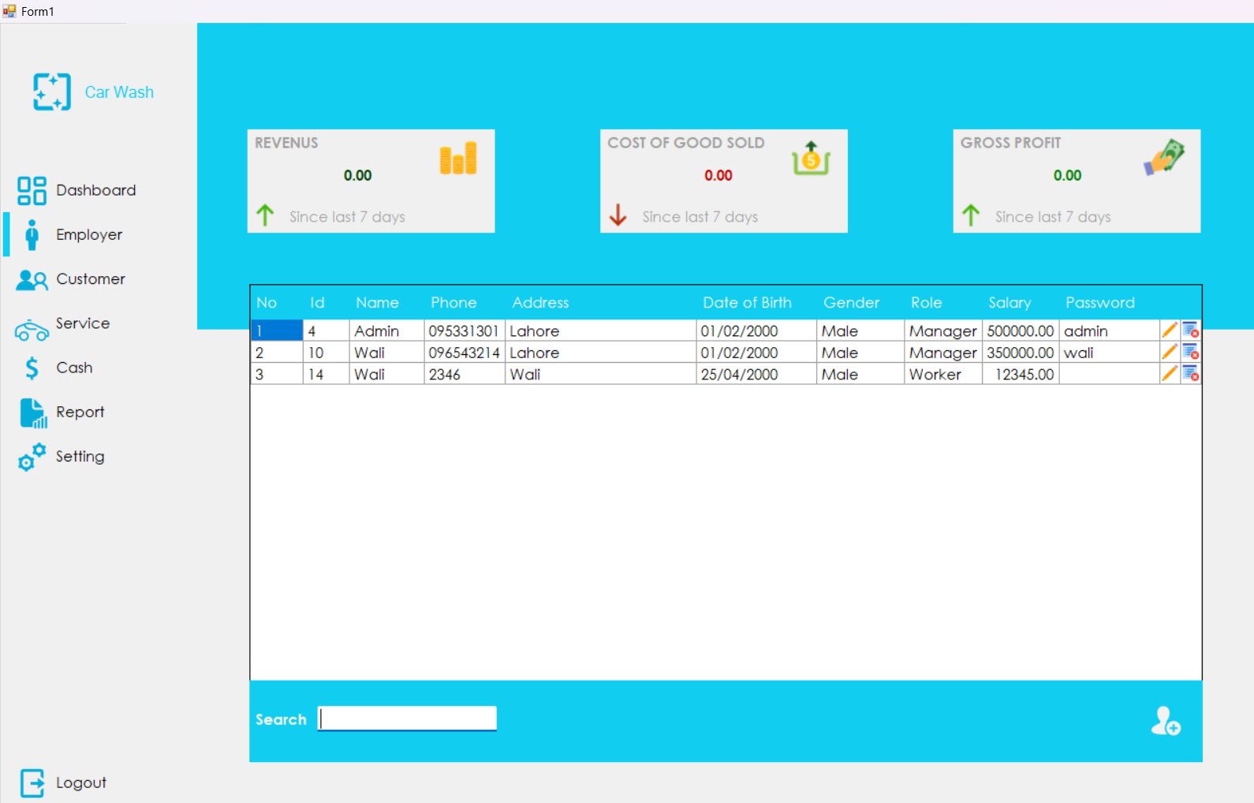

Slide 12
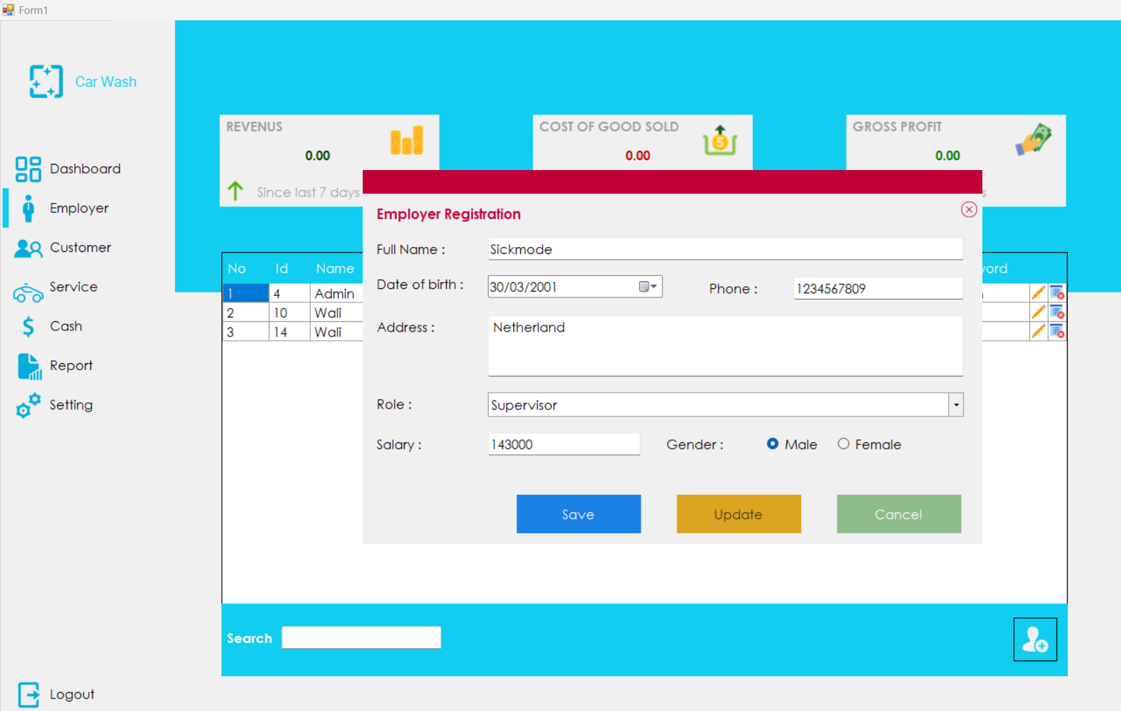

Slide 13
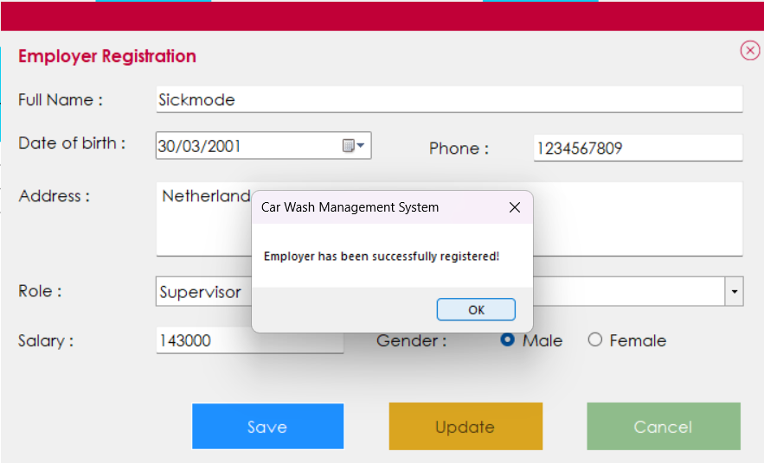

Slide 14
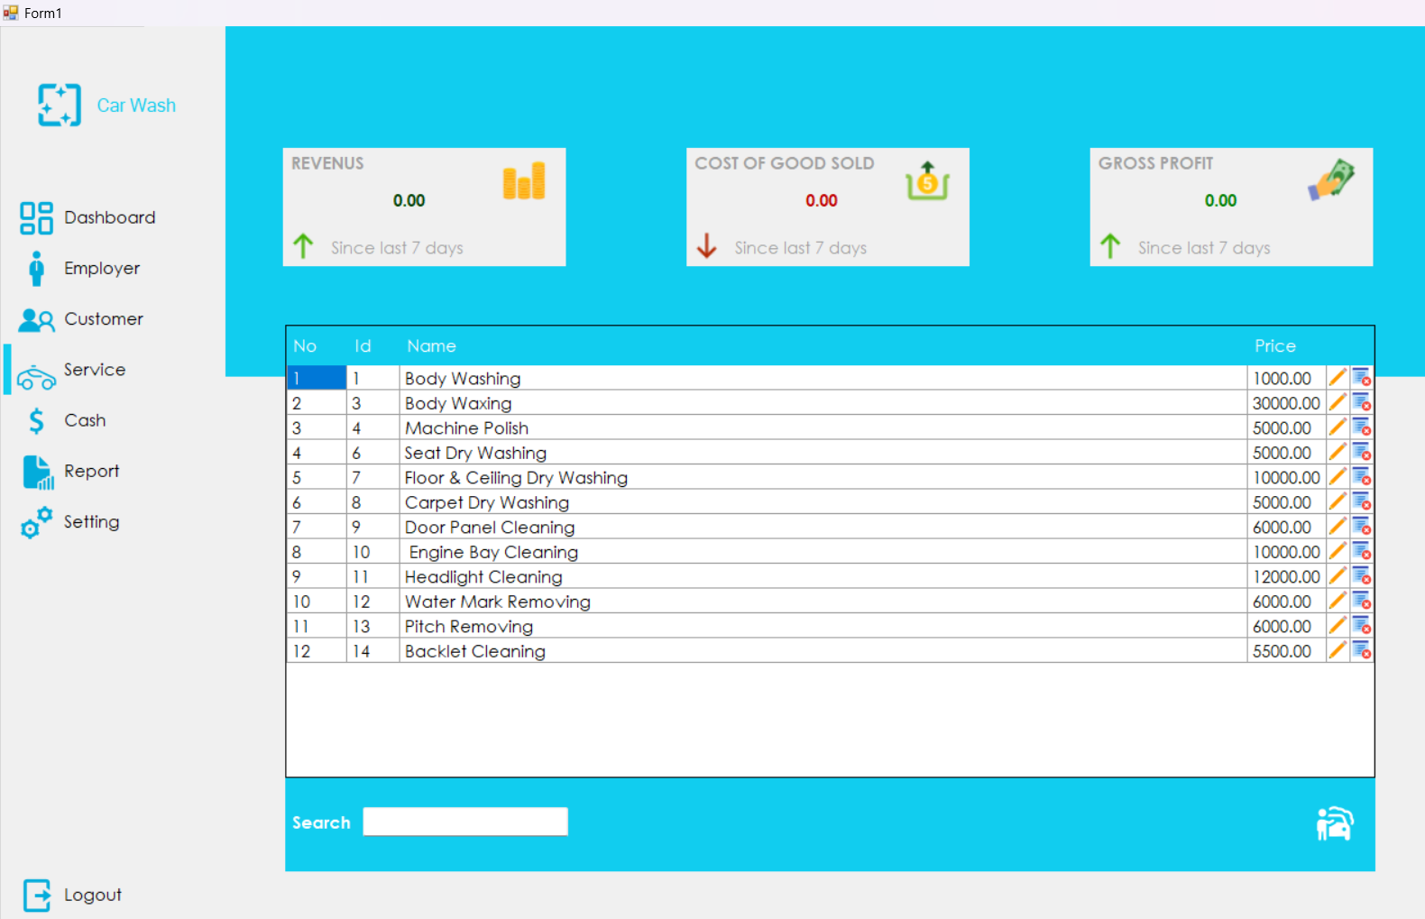
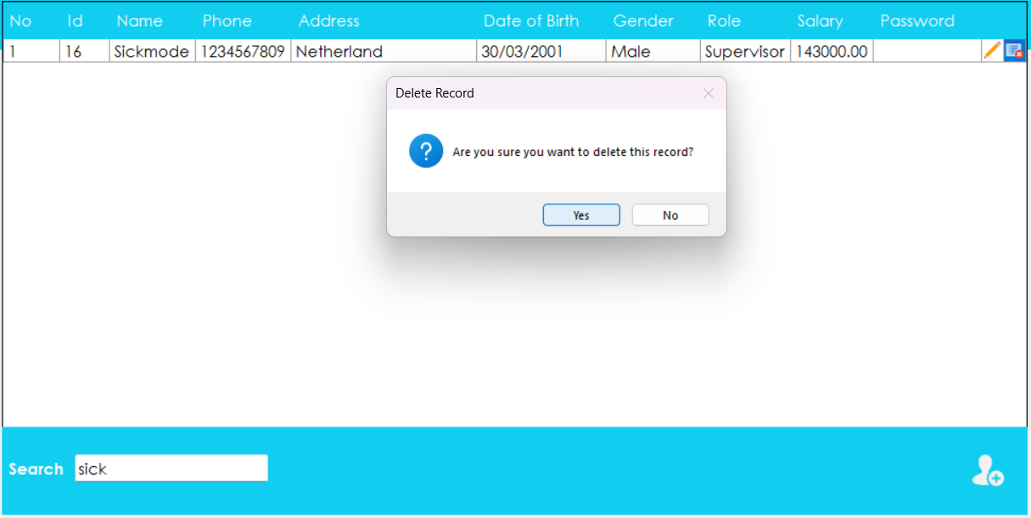

Slide 16
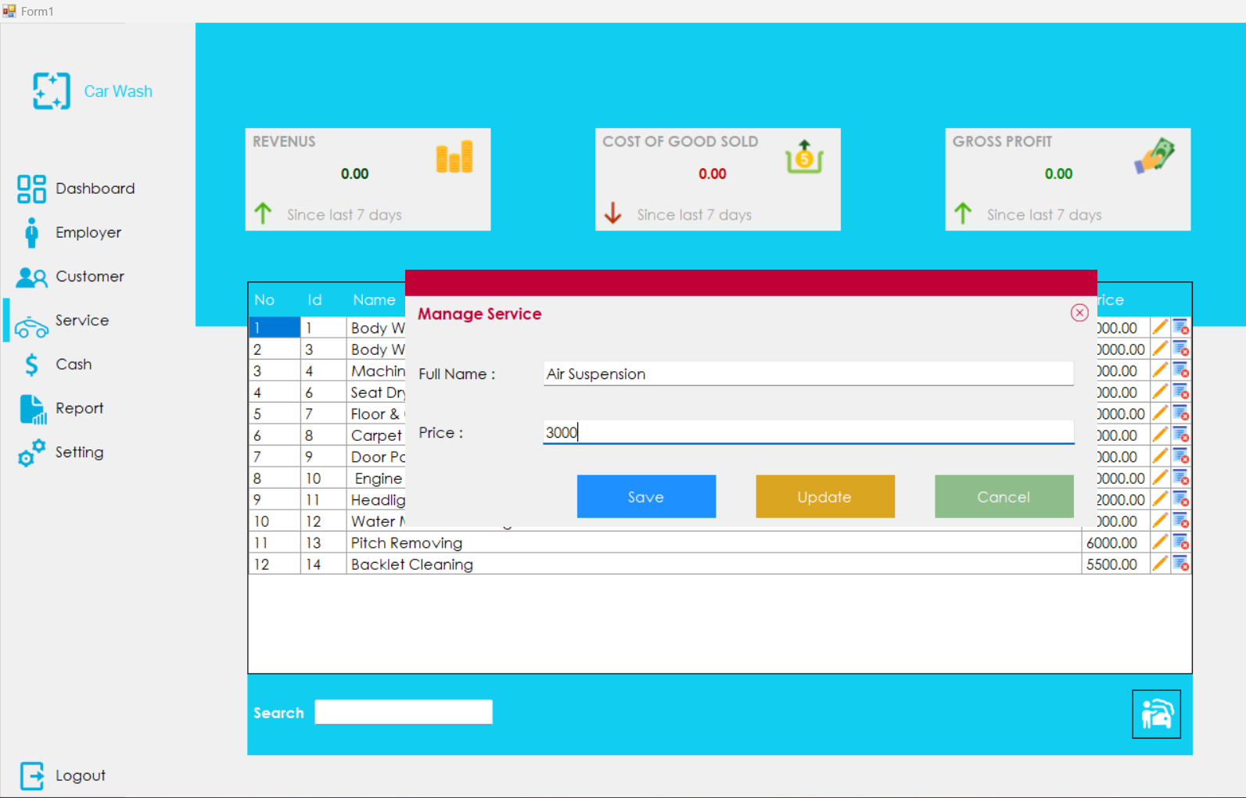

Slide 17
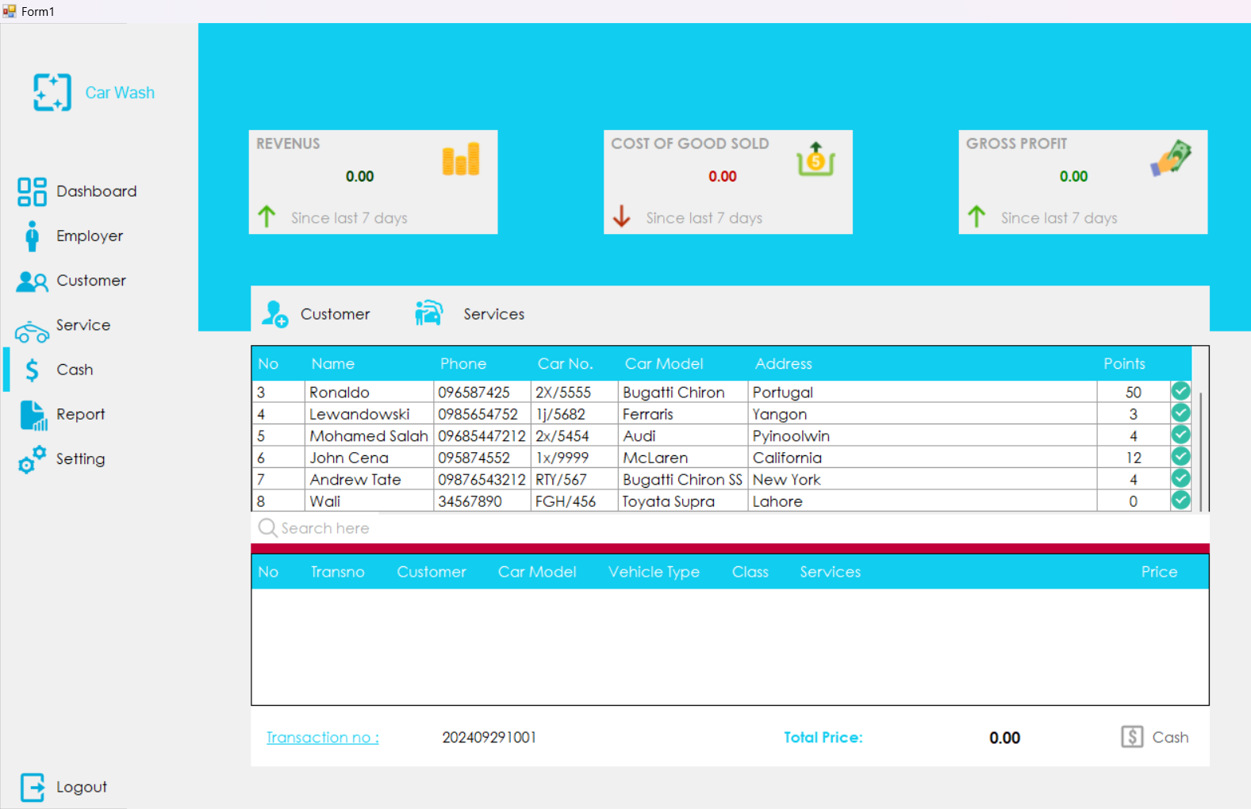

Slide 18
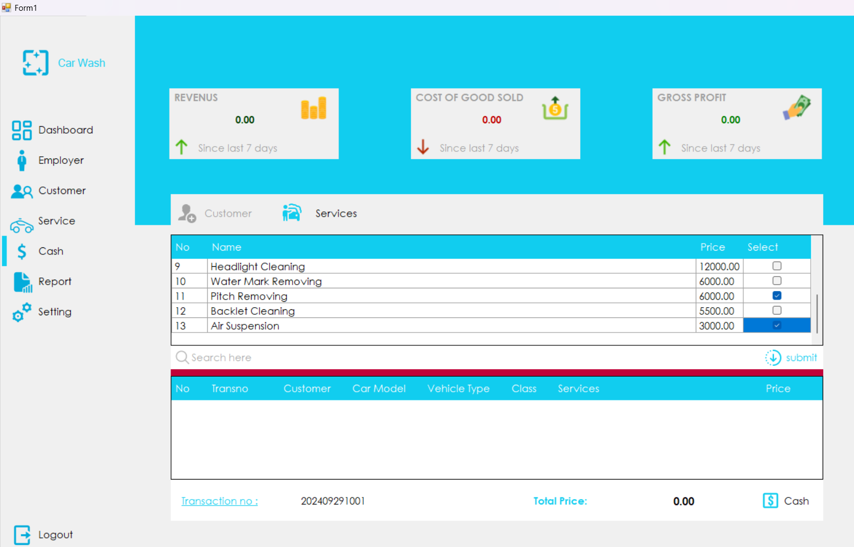

Slide 19
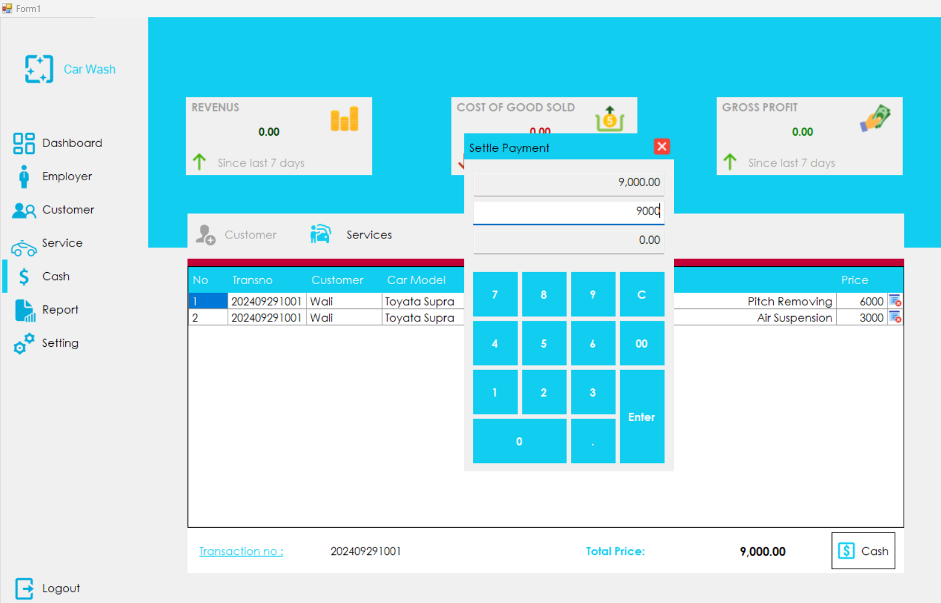

Slide 20
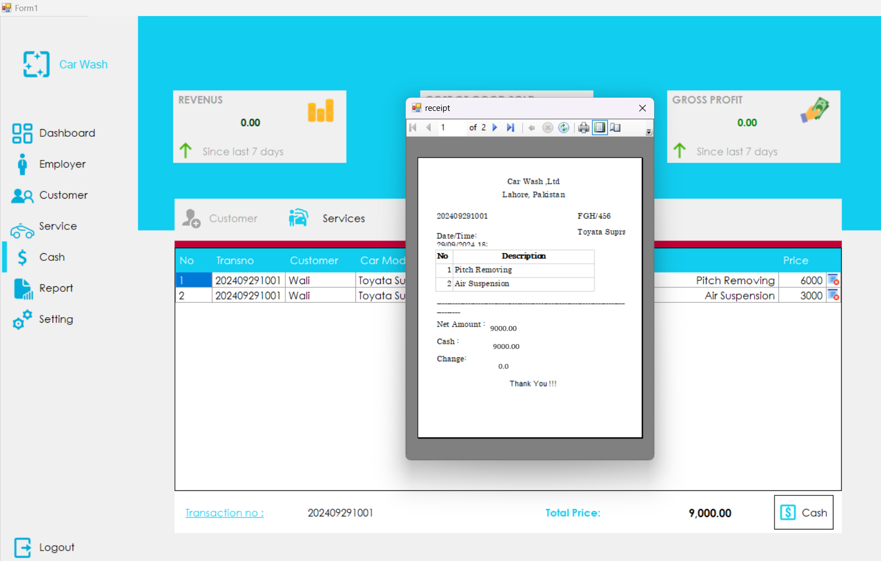

Slide 21
Conclusion
Objectives
Functions
Challenges

Slide 22
Thanks

